Slide 1
Learning From Examples
Md. Nurul Muttakin
Lecturer, CSE, BUET

Slide 2
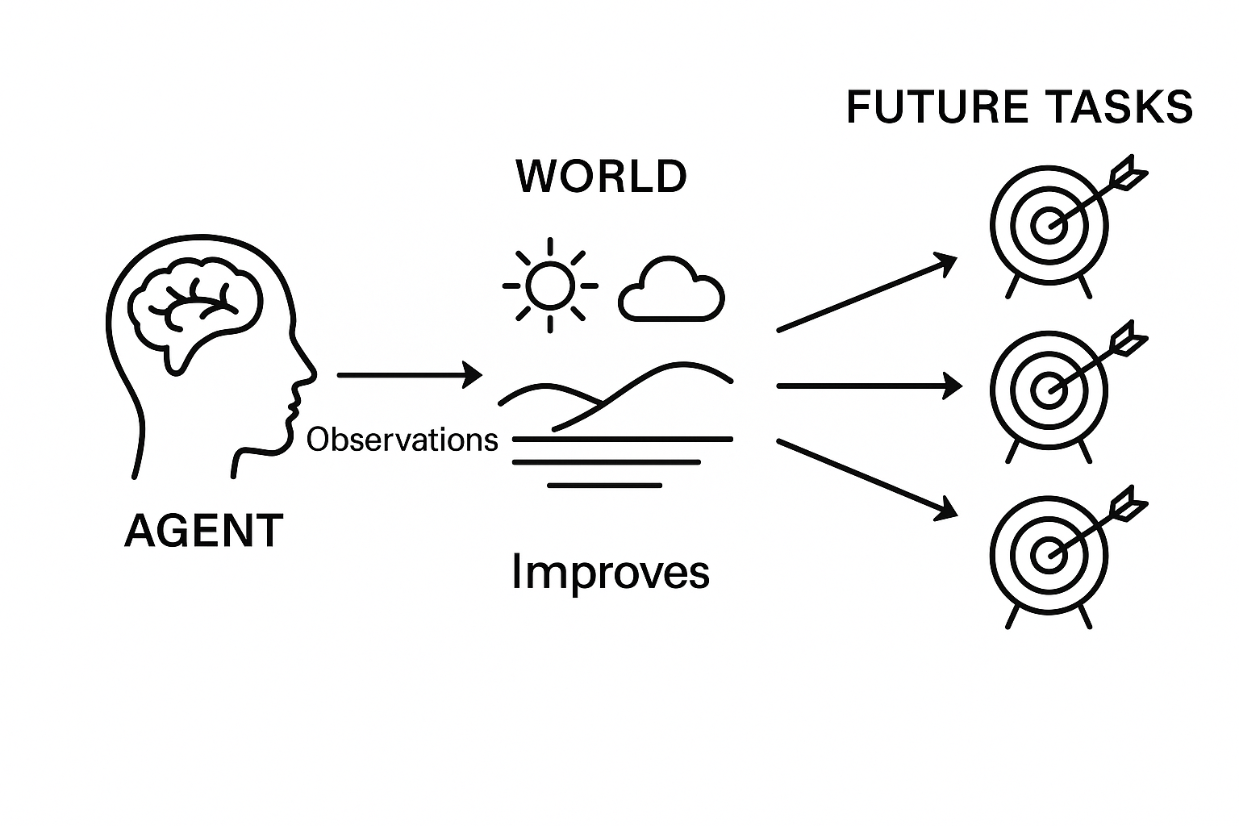
Learning Agent
An agent is learning if it improves its performance on future tasks after making observations about the world.
Notes:
Image source: AI-generated

Slide 3
Learning Agent
Inductive Learning → Specific data to Generic rule
Deductive Learning → Less efficient rule to more efficient rule
Online Learning → Continuously learning over-time
Offline Learning → Pre-learned

Slide 4
Learning Agent
Components to be learned → ?
Utility functions
Actions
Environments etc.
Representation and prior knowledge → ?
Efficient prior knowledge representation
Efficient inference from prior knowledge
Reasoning based on a knowledge base

Slide 5
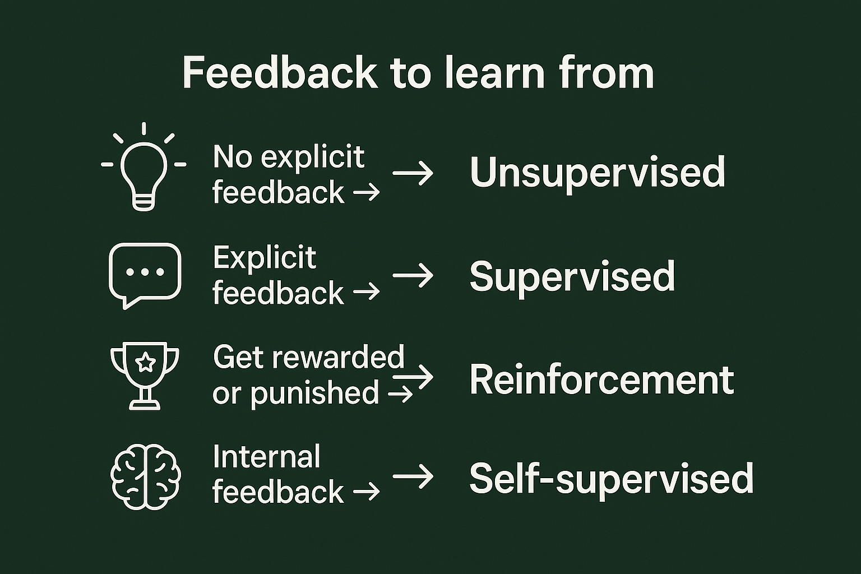
Learning Agent
Feedback to learn from
No explicit feedback → ?
Unsupervised
Explicit feedback →?
Supervised
Get rewarded or punished →?
Reinforcement
Internal feedback →?
Self-supervised
Notes:
Source image: AI-generated

Slide 6
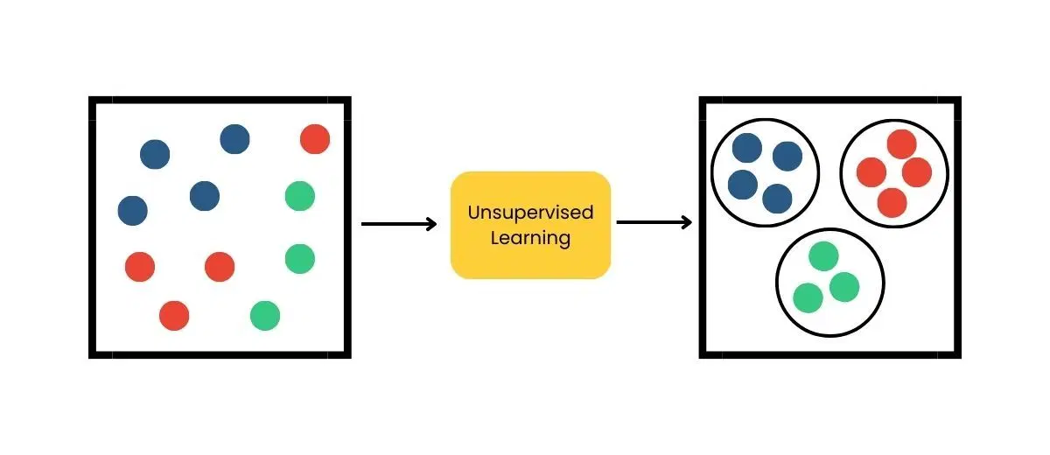
Learning types
Unsupervised: Learn patterns in the input
Example: “Good traffic days” and “bad traffic days” learned by a taxi driver without any label to a day
One common example, clustering
Data do not have labels
Notes:
Image source: https://www.bombaysoftwares.com/blog/introduction-to-unsupervised-learning

Slide 7
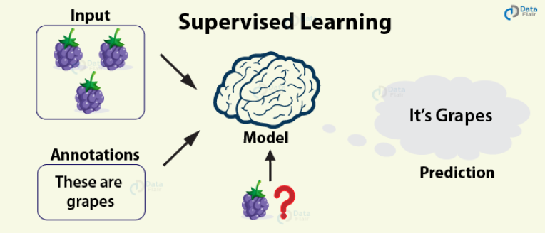
Learning types
Supervised:
Learn from input-output pairs.
Data have labels (i.e., class)
Can predict “Good” or “Bad” from traffic info of a day
Notes:
Image source: https://data-flair.training/blogs/types-of-machine-learning-algorithms/

Slide 8
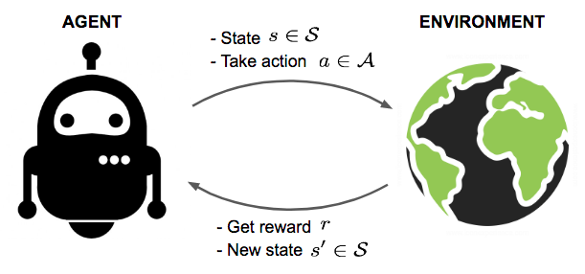
Learning types
Reinforcement:
Learn from reinforcements, rewards and punishments
Example: lack of a tip at the end of a journey an indication that taxi driver did something wrong
Notes:
Source Image: https://vitalflux.com/reinforcement-learning-real-world-examples/

Slide 9
Supervised Learning
Task:
Given a training set of N example input–output pairs (x₁,y₁), (x₂,y₂), … (x_{N},y_{N}) ,
where each y_{j} (ground truth / label) was generated by an unknown function y = f(x),
discover a function h that approximates the true function f.

Slide 10
Supervised Learning
Task:
Discover a function h that approximates the true function f(x).
x=[a, b, ….. ] could be a vector and a, b, etc., are real numbers → Factored Representation of input
If the range of f(x) is a finite set → classification problem →Eg., Day type{rainy, cloudy, sunny}
If the range of f(x) is a number → regression problem → Eg., Temperature

Slide 11
Supervised Learning
Task:
Discover a function h that approximates the true function f(x).
h is the approximator function
Approximator → Approximates the true function
Hypothesis → Hypothesizes on the true function
Predictor → Predicts the true function
Model → Models the true function

Slide 12
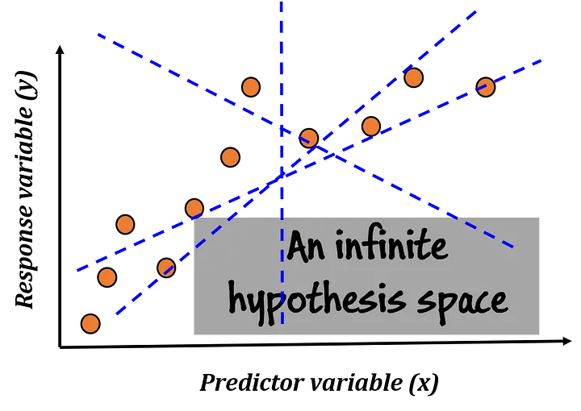
Supervised Learning
Task:
Searching for h in a
Function class H → Approximator function h
Hypothesis space H → Hypothesis h
Predictor class H → Predictor h
Model class H → Model h
Notes:
Image source: https://miro.medium.com/v2/resize:fit:720/format:webp/1*oEqzFfEfIKtkKwa5LoaCog.png

Slide 13
Supervised Learning
Hypothesis space:
How do we choose a hypothesis space?
Exploratory Data Analysis (EDA):
Examining the data with statistical tests
Visualizations—histograms, scatter plots, box plot, etc.

Slide 14
Supervised Learning
Hypothesis space:
Consistent hypothesis, h: For each x_{i} in the training set has h(x_{i}) = y_{i} (categorical value)
Best-fit function, h: For which each h(x_{i}) is close to y_{i} (numerical value)

Slide 15
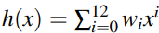
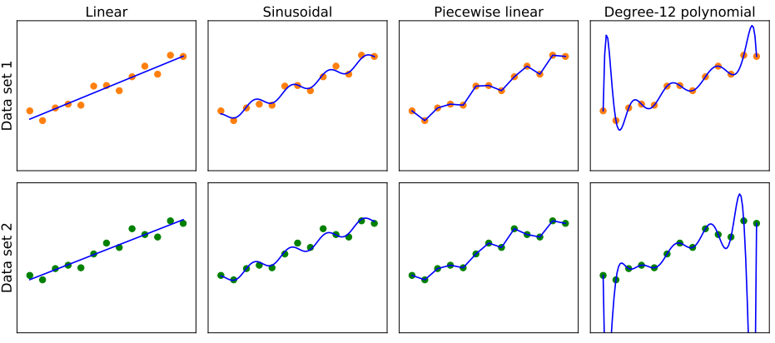
Supervised Learning
Hypothesis space:

Slide 16
Supervised Learning
Measure the hypothesis, h:
Test set: Novel samples not available during training
Generalization: Accurate prediction on test set
Training Error/Loss: Error in prediction on training set
Generalization Error/Loss: Error in prediction on test set

Slide 17
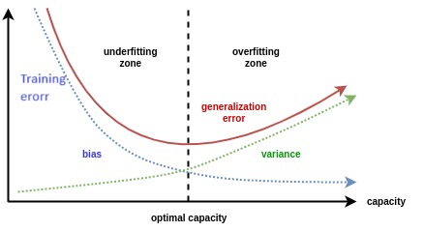
Supervised Learning
Measure the hypothesis, h:
Less Training Error → Less bias → High consistency → Not underfitting
Less Test Error: → Less variance → High generalization → Not overfitting

Slide 18
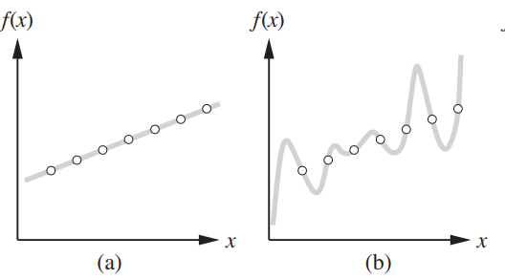
Supervised Learning
Which hypothesis, h, to choose?:
Many consistent hypothesis

Slide 19
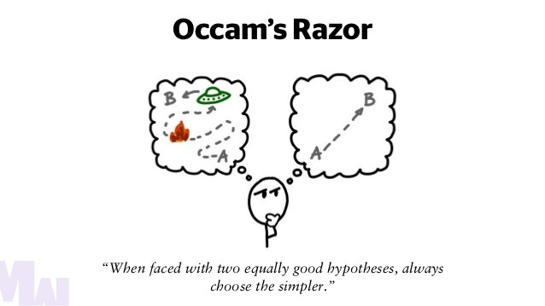
Supervised Learning
Which hypothesis, h, to choose?:
Ockham’s razor: Select the simplest hypothesis consistent with the data
Simplicity: How to define? How to measure?
Simplicity or Appropriateness?

Slide 20
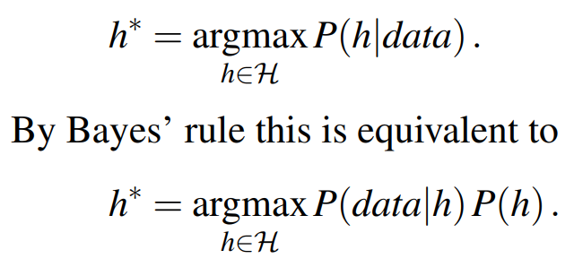
Supervised Learning
Most probable hypothesis, h*:
Choosing the hypothesis h* that is most probable given the data

Slide 21
Supervised Learning
Most probable hypothesis, h*:
P(h) = Prior probability that h holds before seeing the training data
P(data) = Prior probability of observing the training data
P(data|h) = (Likelihood) Probability of observing data in a world where h holds
P(h|data) = (Posterior) Probability of h holding given observed data
Prove that

Slide 22
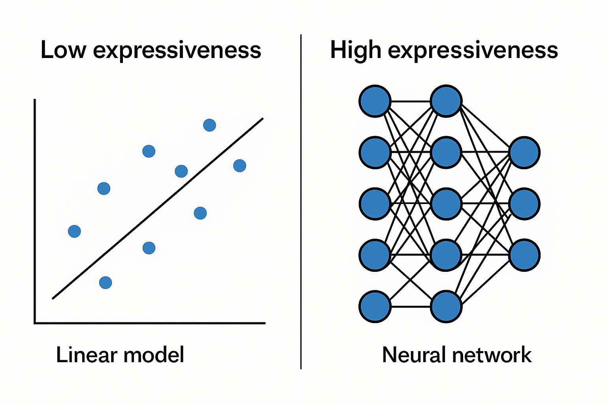
Supervised Learning
Hypothesis space:
Expressiveness: How rich or flexible the hypothesis space is
How many different functions or patterns it can represent
How complex functions it can represent

Slide 23
Supervised Learning
Model Class / Hypothesis Space:
Decision Trees
Linear Models
Non-parametric Models: Nearest Neighbors
Ensemble Models: Random Forest etc.
Neural Networks
Notes:
Image source: https://miro.medium.com/v2/resize:fit:720/format:webp/1*oEqzFfEfIKtkKwa5LoaCog.png

Slide 24
Feedback
Please share your valuable feedback .
Form link: bit.ly/feedback_mnm
Notes:
Image source: https://miro.medium.com/v2/resize:fit:720/format:webp/1*oEqzFfEfIKtkKwa5LoaCog.png

Slide 25
Acknowledgement
Chapter 18 (3rd ed.)/19(4th ed.) (AIAMA) (Textbook)
Lecture Slides of Sukarna Barua sir, Associate Professor, CSE, BUET.
Lecture Slides of Dr. Muhammad Ali Nayeem sir, Assistant Professor, CSE, BUET.
And many other online resources including LLMs.

